Slide 1
Tokens?
There are 6 classes of tokens:
Identifier
2. Keywords
3. Constants
4. Strings
5.Operators

Slide 2
What is an Identifier?
An identifier is the name to denote types, variables, constants or functions, in a C++ program.
C++ is a case-sensitive language.
Identifiers should be descriptive
  Using meaningful identifiers is a good programming practice

Slide 3
Identifier
Identifiers must be unique
Identifiers cannot be reserved words (keywords)
  double main return
Identifier must start with a letter or underscore, and be followed by zero or more letters (A-Z, a-z), digits (0-9), or underscores
VALID
age_of_dog _taxRateY2K Pint
PrintHeading ageOfHorse
Use of two sequential underscore characters ( __ ) in an identifier, or
a single leading underscore followed by a capital letter,
NOT VALID
age# 2000TaxRate Age-Of-Dog main

Slide 4
C++ Data Types
simple
structured
integral enum
floating
array struct union class
char short int long bool
address
float double long double
pointer reference

Slide 5
C++ Primitive Data Types
Primitive types
integral
floating
char short int long bool float double long double
unsigned

Slide 6
Premitive Data Types in C++
Integral Types
  represent whole numbers and their negatives
  declared as int, short, or long
Character Types
  represent single characters
  declared as char
  Stored by ASCII values
Boolean Type
    declared as bool
    has only 2 values true/false
    will not print out directly
Floating Types
  represent real numbers with a decimal point
  declared as float, or double
  Scientific notation where e (or E) stand for “times 10 to the ” (.55-e6)

Slide 7
Samples of C++ Data Values
int sample values
  4578 -4578 0
bool values
  true false
float sample values
  95.274 95.0 .265
char sample values
‘B’ ‘d’ ‘4’ ‘?’ ‘*’

Slide 8
What is a Variable?
A variable is a memory address where data can be stored and changed.
Declaring a variable means specifying both its name and its data type.

Slide 9
What Does a
Variable Declaration Do?
A declaration tells the compiler to allocate enough memory to hold a value of this data type, and to associate the identifier with this location.
int ageOfDog;→
char middleInitial; →
float taxRate;→

Slide 10
Variable Declaration
All variables must declared before use.
  At the top of the program
  Just before use.
Commas are used to separate identifiers of the same type.
  int count, age;
Variables can be initialized to a starting value when they are declared
  int count = 0;
  int age, count = 0;

Slide 11
What is an Expression in C++?
An expression is a valid arrangement of variables, constants, and operators.
In C++, each expression can be evaluated to compute a value of a given type
In C++, an expression can be:
  A variable or a constant (count, 100)
  An operation (a + b, a * 2)
  Function call (getRectangleArea(2, 4))

Slide 12
Constants
Syntax: const type identifier = value;
Ex: const double TAX_RATE = 0.08;
Convention: use upper case for constant ID.

Slide 13
Why use constants?
Tells the user the significance of the number.
Allows the program to be modified easily.
  Ex: Program tax compute has const double TAXRATE=0.0725. If taxes rise to 8%, programmer only has to change the one line to const double TAXRATE=0.08
Safety: Cannot be altered during program execution

Slide 14
Assignment Operator
An operator to give (assign) a value to a variable.
Denote as ‘=‘
Only variable can be on the left side.
An expression is on the right side.
Variables keep their assigned values until changed by another assignment statement or by reading in a new value.

Slide 15
Assignment Operator Syntax
Variable = Expression
  First, expression on right is evaluated.
  Then the resulting value is stored in the memory location of Variable on left.

Slide 16
Assignment Operator Mechanism
Example:
  int count = 0;
  int starting;
  starting = count + 5;
Expression evaluation:
  Get value of count: 0
  Add 5 to it.
  Assign to starting
0
12345 (garbage)
5

Slide 17
Input and Output
C++ treats input and output as a stream of characters.
stream : sequence of characters (printable or nonprintable)
The functions to allow standard I/O are in iostream header file or iostream.h.
Thus, we start every program with
  #include <iostream>
  using namespace std;

Slide 18
Include Directives and Namespaces
include: directive copies that file into your program
namespace: a collection of names and their definitions. Allows different namespaces to use the same names without confusion

Slide 19
Keyboard and Screen I/O
#include <iostream>
input data
output data
executing
program
Keyboard
Screen
cin
(of type istream)
cout
(of type ostream)

Slide 20
Insertion Operator ( << )
Variable cout is predefined to denote an output stream that goes to the standard output device (display screen).
The insertion operator << called “put to” takes 2 operands.
The left operand is a stream expression, such as cout. The right operand is an expression of simple type or a string constant.

Slide 21
Output Statements
SYNTAX
cout statements can be linked together using << operator.
These examples yield the same output:
cout << “The answer is “ ;
cout << 3 * 4 ;
cout << “The answer is “ << 3 * 4 ;
cout << Expression << Expression . . . ;

Slide 22
Output Statements (String constant)
String constants (in double quotes) are to be printed as is, without the quotes.
  cout<<“Enter the number”;
  OUTPUT: Enter the number
“Enter the number” is called a prompt.
All user inputs must be preceded by a prompt to tell the user what is expected.
You must insert spaces inside the quotes if you want them in the output.
Do not put a string in quotes on multiple lines.

Slide 23
Output Statements (Expression)
All expressions are computed and then outputted.
  cout << “The answer is ” << 3 * 4 ;
  OUTPUT: The answer is 12

Slide 24
Escape Sequences
The backslash is called the escape character.
It tells the compiler that the next character is “escaping” it’s typical definition and is using its secondary definition.
Examples:
  new line: \n
  horizontal tab: \t
  backslash: \\
  double quote \”

Slide 25
Newline
cout<<“\n” and cout<<endl both are used to insert a blank line.
Advances the cursor to the start of the next line rather than to the next space.
Always end the output of all programs with this statement.

Slide 26
Extraction Operator (>>)
Variable cin is predefined to denote an input stream from the standard input device (the keyboard)
The extraction operator >> called “get from” takes 2 operands. The left operand is a stream expression, such as cin--the right operand is a variable of simple type.
Operator >> attempts to extract the next item from the input stream and store its value in the right operand variable.

Slide 27
Input Statements
SYNTAX
cin statements can be linked together using >> operator.
These examples yield the same output:
cin >> x;
cin >> y;
cin >> x >> y;
cin >> Variable >> Variable . . . ;

Slide 28
How Extraction Operator works?
Input is not entered until user presses <ENTER> key.
Allows backspacing to correct.
Skips whitespaces (space, tabs, etc.)
Multiple inputs are stored in the order entered:
    cin>>num1>>num2;
    User inputs: 3 4
    Assigns num1 = 3 and num2 = 4

Slide 29
Numeric Input
Leading blanks for numbers are ignored.
If the type is double, it will convert integer to double.
Keeps reading until blank or <ENTER>.
Remember to prompt for inputs

Slide 30
Implicit Conversion
Implicit type conversions are done automatically by the compiler. For this, we take two variables; one of integer type and the another one of float type. Then assign the integer value or variable to the float variable and everything else will be handled by the compiler.
Algorithm
Take an integer value as the input.
Assign the value to a double variable.
Display the output.

Slide 31
#include <iostream>
using namespace std;
double solve(int value)
{
double opVal = value; return opVal;
}
int main()
{
int ip = 25;
double op = solve(ip);
cout<< "The input value is: " << ip << endl; cout<< "The output value is: " << op << endl; return 0;
}
The input value is: 25
The output value is: 25

Slide 32
Explicit conversion
Explicit conversion happens when the programmer specifically instructs the compiler to convert a data type to another. This can be done using two ways, one is by mentioning the data type during assignment, and the another one is using static_cast. We describe the first method before.
Algorithm
Take an integer value as the input;
Assign the value to a double variable using explicit casting to boolean.
Display the output.

Slide 33
#include <iostream>
using namespace std;
double solve(int value) {
double opVal = (double) value;
return opVal; }
int main()
{
int ip = 35;
double op = solve(ip);
cout<< "The input value is: " << ip << endl;
cout<< "The output value is: " << op << endl;
return 0; }
The input value is: 35
The output value is: 35

Slide 34
Arithmetic Operators
Operators: +, -, * /
For floating numbers, the result as same as Math operations.
Note on integer division: the result is an integer. 7/2 is 3.
% (remainder or modulo) is the special operator just for integer. It yields an integer as the result. 7%2 is 1.
Both / and % can only be used for positive integers.
Precedence rule is similar to Math.

Slide 35
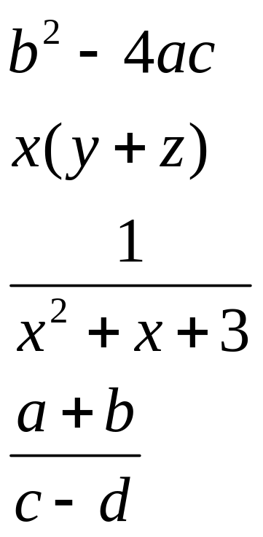
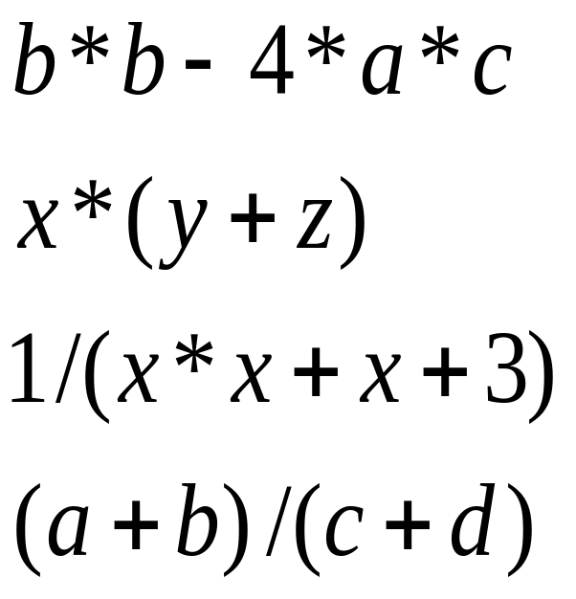
Arithmetic Expressions
Arithmetic operations can be used to express the mathematic expression in C++:

Slide 36
Simple Flow of Control
Three processes a computer can do:
  Sequential
    expressions, insertion and extraction operations
  Selection (Branching)
    if statement, switch statement
  Repetition/Iteration (Loop)
    while loop, do-while loop, for loop

Slide 37
bool Data Type
Type bool is a built-in type consisting of just 2 values, the constants true and false
We can declare variables of type bool
  bool hasFever; // true if has high temperature
  bool isSenior; // true if age is at least 55
The value 0 represents false
ANY non-zero value represents true

Slide 38
Boolean Expression
Expression that yields bool result
Include:
  6 Relational Operators
  < <= > >= == !=
  3 Logical Operators
  ! && ||

Slide 39
Relational Operators
int x, y ;
x = 4;
y = 6;
EXPRESSION VALUE
x < y true
x + 2 < y false
x != y true
x + 3 >= y true
y == x false
y == x+2 true
y = x + 3 7
y = x < 3 0
y = x > 3 1

Slide 40
Logical Operators
are used in boolean expressions of form:
ExpressionA Operator ExpressionB
A || B (true if either A or B or both are true. It is false otherwise)
A && B (true if both A and B are true. It is false otherwise)
or
Operator Expression
!A (true if A is false. It is false if A is true)
Notes:
Highest precedence for NOT, AND and OR are low precedence.
Associate left to right with low precedence. Use parenthesis to override priority or for clarification
  x && y || z will evaluate “x && y ” first
  x && (y || z) will evaluate “y || z” first

Slide 41
Precedence Chart
++, --, !, - (unary minus), + (unary plus)
*, /, %
+ (addition), - (subtraction)
<<, >>
<, <=, >, >=
==, !=
&&
||
=
Highest
Lowest

Slide 42
OPERATOR PRECEDENCE
Consider the following arithmetic operation:
    - left to right
    6 / 2 * 1 + 2 = 5
    - right to left
    6/2 * 1 + 2 = 1 Inconsistent answers!
    - using parentheses
    = 6 / (2 * 1) + 2
    = (6 / 2) + 2
    = 3 + 2
    = 5

Slide 43
RULES for Operator Precedence:
a rule used to clarify unambiguously which operations (operator and operands) should be performed first in the given (mathematical) expression.
Use precedence levels that conform to the order commonly used in mathematics.
However, parentheses take the highest precedence and operation performed from the innermost to the outermost parentheses.

Slide 44
Precedence and Associativity of C++ operators affect the grouping and evaluation of operands in expressions.
It is meaningful only, if other operators with higher or lower precedence are present.
Expressions with higher-precedence operators are evaluated first.
If several operators appear together, they have equal precedence then they are evaluated according to their associativity.

Slide 45
OPERATOR PRECEDENCE
Precedence and Associativity of C++ Operators
Symbol | Type of Operation | Associativity
[ ] ( ) . –> postfix ++ and postfix –– | Expression | Left to right
prefix ++ and prefix –– sizeof & * + – ~ ! | Unary | Right to left
typecasts | Unary | Right to left
* / % | Multiplicative | Left to right
+ – | Additive | Left to right
<< >> | Bitwise shift | Left to right
< > <= >= | Relational | Left to right
== != | Equality | Left to right
& | Bitwise-AND | Left to right
^ | Bitwise-exclusive-OR | Left to right
| | Bitwise-inclusive-OR | Left to right
&& | Logical-AND | Left to right
|| | Logical-OR | Left to right
? : | Conditional-expression | Right to left
= *= /= %= += –= <<= >>= &= ^= |= | Simple and compound assignment | Right to left
, | Sequential evaluation | Left to right

Slide 46
OPERATOR PRECEDENCE
e.g:
Order of operations is not defined by the language.
The compiler is free to evaluate such expressions in any order, if the compiler can guarantee a consistent result.
3 + 5 + (3 + 2) = 13 – right to left
(3 + 5) + 3 + 2 = 13 – left to right
3 + (5 + 3) + 2 = 13 – from middle

Slide 47
OPERATOR PRECEDENCE
Logical operators also guarantee evaluation of their operands from left to right.
But, they evaluate the smallest number of operands needed to determine the result of the expression.
This is called "short-circuit" evaluation.
Thus, some operands of the expression may not be evaluated.

Slide 48
OPERATOR PRECEDENCE
For example:
The second operand, y++, is evaluated only if x is true (nonzero).
Thus, y is not incremented if x is false (0).
x && y++

Slide 49
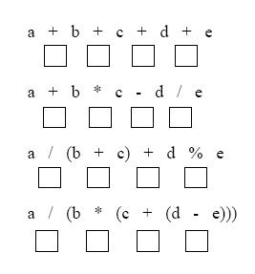
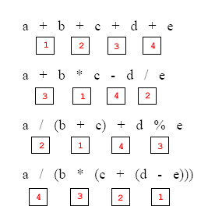
OPERATOR PRECEDENCE
Label the execution order for the following expressions

Slide 50
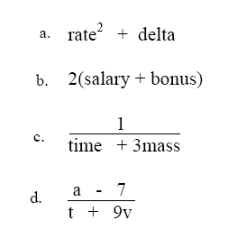
OPERATOR PRECEDENCE
Convert the following operations to C++ expression
(rate*rate) + delta
2*(salary + bonus)
1/(time + (3*mass))
(a - 7) / (t + (9 * v))
www.tenouk.com, ©
45/46

Slide 51
Simple if Statement
Is a selection of whether or not to execute a statement or a block of statement.
TRUE
expression
statement(s)
FALSE

Slide 52
Simple if Statement Syntax
if (Boolean Expression)
Statement
if (Bool-Expr)
{
Statement_1
…
Statement_n
}

Slide 53
These are NOT equivalent. Why?
if (number == 0 )
{
  cout << “Number that ”;
  cout << “You entered invalid number.\n”;
}
When number has value 0, the output will be:
Number that You entered invalid number.
When number has value
NOT 0(number != 0), there is NO output.
if (number == 0 )
  cout << “Number that ”;
  cout << “You entered invalid number.\n”;
When number has value 0, the output will be:
Number that You entered invalid number.
When number has value NOT 0, the output will be:
You entered invalid number.

Slide 54
If-else Statement
provides selection between executing one of 2 clauses (the if clause or the else clause)
TRUE
FALSE
expression
if clause
else clause

Slide 55
Use of blocks
Denoted by { .. }
Recommended in controlled structures (if and loop)
Also called compound statement.
if (Bool-Expression )
{
}
else
{
}
“if clause”
“else clause”

Slide 56
Nested if Example
int main()
{
// declaring three numbers
int a = 10;
int b = 2;
int c = 6;
// outermost if else
if (a < b) {
// nested if else
if (c < b) {
cout<<b<<“is the greatest”<<endl;
}
else {
cout<<c<<“is the greatest”<<endl;
}
}
else {

Slide 57
// nested if else
if (c < a) {
cout<<a<<“is the greatest“<<endl;
}
else {
cout<< c<<“is the greatest“<<endl;
}
}
return 0;
}
O/P: 10 is the greatest

Slide 58
Loop
is a repetition control structure.
causes a single statement or block of statements to be executed repeatedly until a condition is met.
There are 3 kinds of loop in C++:
  While loop
  Do-While loop
  For loop

Slide 59
While Loop
SYNTAX
while ( Expression )
{
… // loop body
}
No semicolon after the boolean expression
Loop body can be a single statement, a null statement, or a block.

Slide 60
While Loop Mechanism
When the expression is tested and found to be false, the loop is exited and control passes to the statement which follows the loop body.
When the expression is tested and found to be true, the loop body is executed. Then, the expression is tested again.
FALSE
Expression
TRUE
body
statement

Slide 61
While Loop Example
int count ;
count = 0; // initialize LCV (loop control variable)
while (count < 5) // test expression
{
cout << count << “ ”; // repeated action
count = count + 1; // update LCV
}
cout << “Done” << endl ;

Slide 62
Loop Tracing
int count ;
count = 0;
while (count < 5)
{
cout << count << “ ”;
count = count + 1;
}
cout << “Done” << endl ;
count Expression Output
0 true 0
1 true 0 1
2 true 0 1 2
3 true 0 1 2 3
4 true 0 1 2 3 4
5 false 0 1 2 3 4 Done

Slide 63
Increment and Decrement Operators
Denoted as ++ or --
Mean increase or decrease by 1
Pre increment/decrement: ++a, --a
  Increase/decrease by 1 before use.
Post increment/decrement: a++, a--
  Increase/decrease by 1 after use.
Pre and Post increment/decrement yield different results when combining with another operation.

Slide 64
Pre and Post
Increment and Decrement
int count ;
count = 0;
while (count < 5)
{
cout << count++ << “ “ ;
}
cout << “Done” << endl ;
count Expression Output
0 true 0
1 true 0 1
2 true 0 1 2
3 true 0 1 2 3
4 true 0 1 2 3 4
5 false 0 1 2 3 4 Done
int count ;
count = 0;
while (count < 5)
{
cout << ++count << “ “ ;
}
cout << “Done” << endl ;
count Expression Output
0 true 1
1 true 1 2
2 true 1 2 3
3 true 1 2 3 4
4 true 1 2 3 4 5
5 false 1 2 3 4 5 Done

Slide 65
Do-While Loop
SYNTAX
do
{
… // loop body
} while ( Expression );
Insured that the loop is executed at least once
The LCV is initialized/updated before the end of the loop.
Boolean expression is tested at the end of the loop.
There is a semicolon after the boolean expression.

Slide 66
Do-While Loop Mechanism
The loop body is executed first
When the expression is tested and found to be false, the loop is exited and control passes to the statement which follows the loop body.
When the expression is tested and found to be true, the loop body is executed. Then, the expression is tested again.
body
statement
FALSE
TRUE
Expression

Slide 67
Do-While Loop Example
int ans;
do
{
cout << “Choose a number from 1 to 4: “;// repeated action
cin >> ans; // LCV is initialized or updated
} while (ans >= 1 && ans <= 4); // test expression
cout << “Done”;
Output Input ans Expression
Choose a number from 1 to 4: 2 2 true
Choose a number from 1 to 4: 3 3 true
Choose a number from 1 to 4: 1 1 true
Choose a number from 1 to 4: 5 5 false
Done

Slide 68
Count-Controlled Loop
Has a loop control variable (LCV) as a counter.
LCV must be
  Initialized before start of the loop
  Tested (boolean expression)
  Updated

Slide 69
Ask-before-Continuing
char ans = ‘y’; // LCV is initialized
while (ans == ‘Y’ || ans == ‘y’) // test expression
{
doSomething; // repeated action
cout << “Do you want to continue? ”;
cin >> ans; // LCV is updated
};

Slide 70
BREAK statement
allows to exit from any loop.
#include <iostream>
using namespace std;
int main()
{int x;
do
{
cin>>x;
if (x % 2 ==0)
break;
} while (x > 0); // exits when an even number is entered
5
7
9
5
3
2
6
dash: 2: 6: not found

Slide 71
CONTINUE Statement
allows you to skip the rest of the loop body and go back to the beginning of the loop.
#include <iostream>
using namespace std;
int main()
{int x;
do
{
cin>>x;
if (x % 2 == 0)
continue;
cout<<x<<endl;
} while (x <100);
//prints out all odd numbers entered less than 100
33
33
99
99
100
11
dash: 2: 11: not found

Slide 72
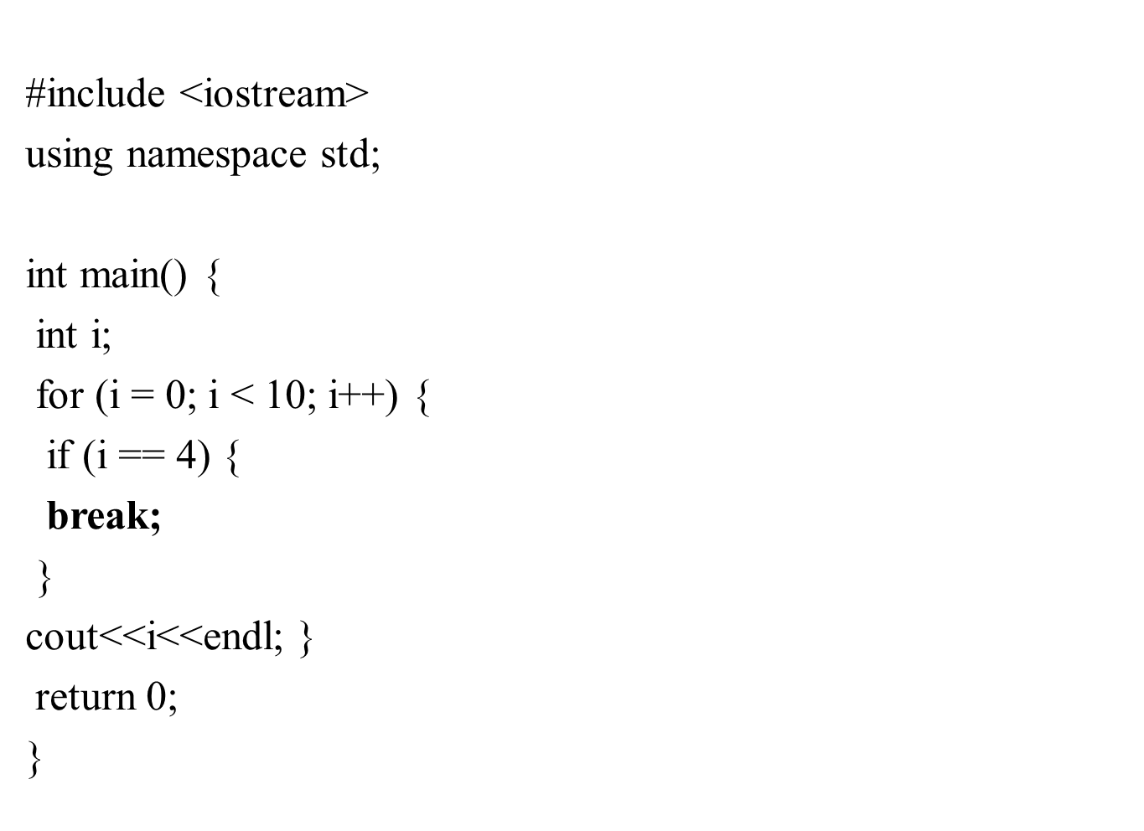
O/P:
0
1
2
3

Slide 73
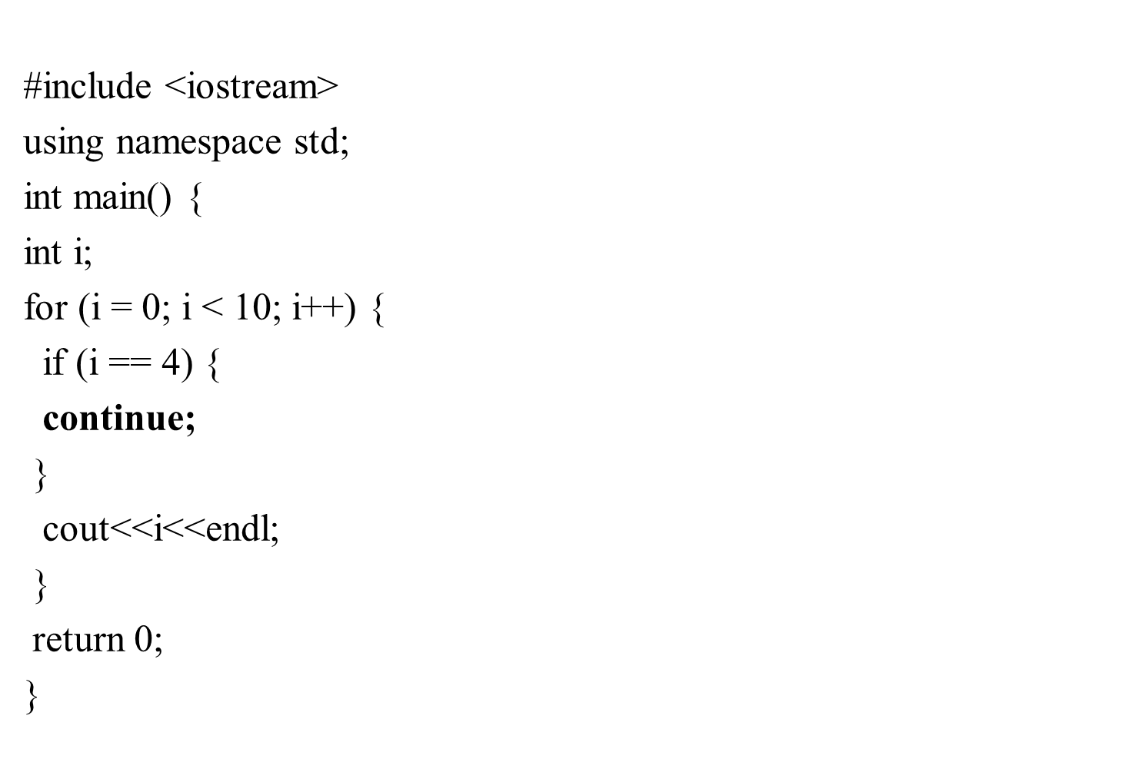
0
1
2
3
5
6
7
8
9
O/P

Slide 74
Switch Statement Details
The last statement of each case in the switch should almost always be a break.
The break causes program control to jump to the closing brace of the switch structure.
Without the break, the code flows into the next case. This is almost never what you want.
A switch statement will compile without a default case, but always consider using one.

Slide 75
Creating Menus
When you want to give your user a choice on what to do next, you can display a set of choices (a menu). The user then enters his or her choice. You must validate the choice to make sure it is valid before you continue the program!

Slide 76
Sample Program
#include <iostream>
using namespace std;
int main() {
int choice;
choice = 0;
do { cout<<"my menu"<<endl;
cout<<"1 edit"<<endl;
cout<<"2 delete"<<endl;
cout<<"3 quit"<<endl;
cout<<“enter your choice:”;
cin>>choice;

Slide 77
Sample Program (cont’d)
} while ( ( choice >= 1 ) && ( choice <= 3 ) );
switch( choice )
{ case 1: cout<<"Do edit";
break;
case 2: cout<<"Do delete";
break;
case 3: cout<<"Done";
break;
default: cout<<"Invalid choice!";
break;}}

Slide 78
Good Programming Practices
Include a default case to catch invalid data.
Inform the user of the type of error that has occurred (e.g., “Error - invalid day.”).

Slide 79
switch Example
switch ( day )
{
case 0: cout <<“Sunday\n” ;
break ;
case 1: cout <<“Monday\n” ;
break ;
case 2: cout<<“Tuesday\n” ;
break ;
case 3: cout<<“Wednesday\n” ;
break ;
case 4: cout<<“Thursday\n” ;
break ;
case 5: cout <<“Friday\n” ;
break ;
case 6: cout<<“Saturday\n” ;
break ;
default: cout<<“Error -- invalid day.\n” ;
break ;
}
Is this structure more efficient than the equivalent nested if-else structure?

